Slide 1

Unit Testing
Building Rock-Solid Software
SoftUni Team
Technical Trainers
Software University
https://softuni.bg

Slide 2
Table of Contents
Seven Testing Principles
What is Unit Testing?
Unit Testing Frameworks
NUnit
3A-s Pattern
Good Practices

Slide 3
Questions
sli.do #csharp-advanced

Slide 4

Seven Testing Principles

Slide 5
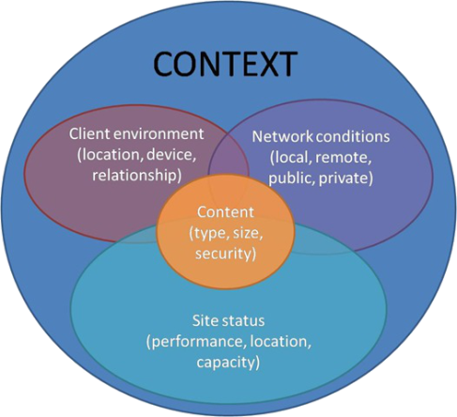
Seven Testing Principles
Testing is context dependent
Testing is done differently in different contexts
Example:
Safety-critical software is tested differently from an e-commerce site
5

Slide 6
Seven Testing Principles (1)
Exhaustive testing is impossible
All combinations of inputs and preconditions are usually almost infinite number
Testing everything is not feasible
Except for trivial cases
Risk analysis and priorities should be used to focus testing efforts

Slide 7
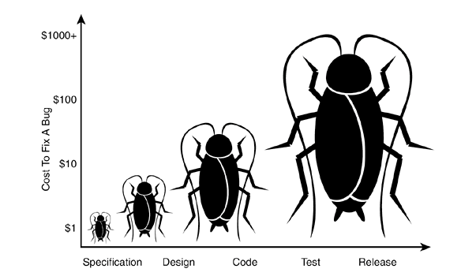
Seven Testing Principles (2)
Early testing is always preferred
Testing activities shall be started as early as possible
And shall be focused on defined objectives
The later a bug is found – the more it costs!

Slide 8
Seven Testing Principles (3)
Defect clustering
Testing effort shall be focused proportionally
To the expected and later observed defect density of modules
A small number of modules usually contains most of the defects discovered
Responsible for most of the operational failures
Notes:
In your opinion which operation is most likely to cause your Operation system to fail?
- Opening Microsoft Word
- Open IE
- Opening 10 different application all at the same time

Slide 9
Seven Testing Principles (4)
Pesticide paradox
Same tests repeated over and over again tend to lose their effectiveness
Previously undetected defects remain undiscovered
New and modified test cases should be developed

Slide 10
Seven Testing Principles (5)
Testing shows presence of defects
Testing can show that defects are present
Cannot prove that there are no defects
Appropriate testing reduces the probability for defects

Slide 11
Seven Testing Principles (6)
Absence-of-errors fallacy
Finding and fixing defects itself does not help in these cases:
The system built is unusable
Does not fulfill the users’ needs and expectations

Slide 12

Software Used to Test Software
What is Unit Testing?

Slide 13
Manual Testing
Not structured
Not repeatable
Can’t cover all of the code
Not as easy as it should be
void TestSum()
{
if (this.Sum(1, 2) != 3)
throw new Exception("1 + 2 != 3");
}
13

Slide 14
Moving Away from Manual Testing
We need a structured approach that:
Allows refactoring
Reduces the cost of change
Decreases the number of defects in the code
Bonus:
Improves design

Slide 15
Automated Testing
More types of testing: Regression, UI, Load, Performance, Stress, Security, Manual, Acceptance, Black-box, A/B, etc.
System tests
Integration tests
Unit tests
System
Integration
Unit
15

Slide 16
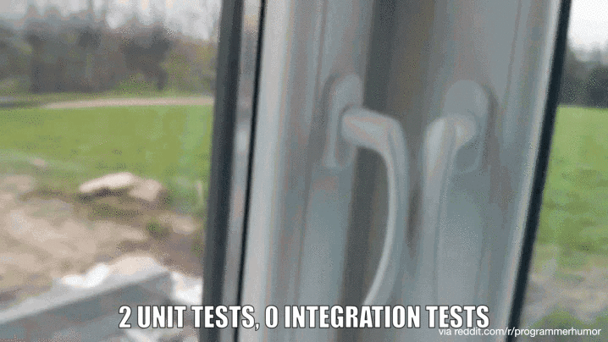
Integration Tests
16

Slide 17

Unit Testing Frameworks

Slide 18
NUnit
Initially ported from Junit
NUnit version 3.0, has been completely rewritten
NUnit is an Open Source software
Support for a wide range of .NET platforms
18

Slide 19
NUnit vs MSTest
NUnit allows for parameterized tests
Readable Assert method
NUnit has frequent version updates
Expected exception message assertion can be done using attribute in NUnit
MS-Test has only one update per VS version
Expected exception message assertion must be done using Try-Catch in MS-Test

Slide 20
Problem: NUnit Test
Create console application project
Add BankAccount class
Create NUnit Project
Test the BankAccount class

Slide 21
Solution: NUnit Test (1)
Create a class library (.Net Core)
Name it like the project you are testing, but with ".Tests" suffix
Right click on the project to open the NuGet package manager
Create a console applicaton
Add BankAccount class for us to test
BankAccount
+Amount : decimal
+BankAccount(decimal)

Slide 22
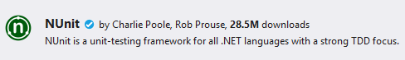
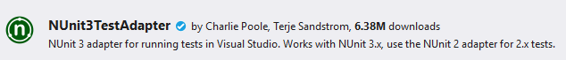
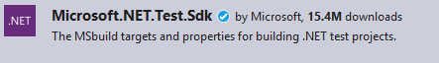
Solution: NUnit Test (2)
Install NUnit
Install NUnit3TestAdapter
Install Microsoft.Net.Test.Sdk
Open Test Explorer (Ctrl + E, T or Test->Windows ->TestExplorer)

Slide 23
Solution: NUnit Test (3)
Write your first test
Attribute that marks a class that contains tests
[TestFixture]
public class BankAcountTests
{
[Test]
public void AccountInitializeWithPositiveValue() {
BankAccount account = new BankAccount(2000m);
Assert.That(account.Amount, Is.EqualTo(2000m));
}
}
Test Method
Assert class comes with NUnit

Slide 24
What is AAA Testing Pattern
Organize and clarify test code by breaking down a test case into the following functional sections:
The Arrange section of a unit test initializes objects and sets the value of the data that is passed to the test case
The Act section invokes the test case with the arranged parameters
The Assert section verifies the test case behaves as expected

Slide 25
3A Pattern
[Test]
public void DepositShouldAddMoney()
{
BankAccount account = new BankAccount();
account.Deposit(50);
Assert.That(account.Balance, Is.EqualTo(50));
}
Each test should test a single behavior!

Slide 26
Problem: Test Axe
Load provided solution in Visual Studio
Add new test project Tests
Create a class AxeTests
Create the following tests:
Test if weapon loses durability after attack
Test attacking with a broken weapon

Slide 27
Solution: Test Axe (1)
[Test]
public void AxeLosesDurabilyAfterAttack()
{
// Arrange
Axe axe = new Axe(10, 10);
Dummy dummy = new Dummy(10, 10);
// Act
axe.Attack(dummy);
// Assert
Assert.That(axe.DurabilityPoints, Is.EqualTo(9));
}

Slide 28
Solution: Test Axe (2)
[Test]
public void BrokenAxeCantAttack()
{
Axe axe = new Axe(1, 1);
Dummy dummy = new Dummy(10, 10);
axe.Attack(dummy);
Assert.That(() => axe.Attack(dummy),
Throws.InvalidOperationException
.With.Message.EqualTo("Axe is broken."));
}

Slide 29
Problem: Test Dummy
Create a class DummyTests
Create the following tests
Dummy loses health if attacked
Dead Dummy throws exception if attacked
Dead Dummy can give XP
Alive Dummy can't give XP

Slide 30
Solution: Test Dummy
[Test]
public void DummyLosesHealthAfterAttack()
{
// Arrange
Dummy dummy = new Dummy(20, 10);
// Act
dummy.TakeAttack(5);
// Assert
Assert.That(dummy.Health, Is.EqualTo(15));
}
// TODO: Write the rest of the tests

Slide 31

How to Write Good Tests
Unit Testing Best Practices

Slide 32
Asserts (1)
Condition
Comparison
Exception
Assert.That(bool condition);
Assert.That(actual, Is.EqualTo(expected));
Assert.That(() => { code },
Throws.ExpectedException);

Slide 33
Asserts (2)
String Assert
Collection Assert
File Assert
Assert.That(string actual,
Does.Contain(string expected));
Assert.That(IEnumerable expected Has.Member(object actual));
Assert.That(string filePath, Does.Exist);
Assert.That(FileInfo file, Does.Exist);

Slide 34
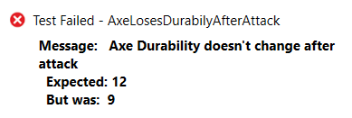
Assertion Messages
Assertions can show messages
Helps with diagnostics
Assert.That(axe.DurabilityPoints, Is.EqualTo(12),
"Axe Durability doesn't change after attack");
Test failure messages help to find the problem

Slide 35
Don't Repeat Yourself
private BankAccount account;
[SetUp]
public void TestInit()
{
this.account = new BankAccount();
}
[TearDown]
public void TestCleanUp() { … }
Executes before each test
Executes after each test

Slide 36


Naming Test Methods
Test names
Should use business domain terminology
Should be descriptive and readable
IncrementNumber() {}
Test1() {}
TestTransfer() {}
DepositAddsMoneyToBalance() {}
DepositNegativeShouldNotAddMoney() {}
TransferSubtractsFromSourceAddsToDestAccount() {}

Slide 37
Problem: Refactor Tests
Refactor the tests for Axe and Dummy classes
Make sure that:
Names of test methods are descriptive
You use appropriate assertions (assert equals vs assert true)
You use assertion messages
There are no magic numbers
There is no code duplication (Don’t Repeat Yourself)

Slide 38
Solution: Refactor Tests (1)
private Axe axe;
private Dummy dummy;
[SetUp]
public void TestInit()
{
this.axe = new Axe(2, 2);
this.dummy = new Dummy(20, 20);
}

Slide 39
Solution: Refactor Tests (2)
[Test]
public void AxeLosesDurabilyAfterAttack()
{
axe.Attack(dummy);
Assert.That(axe.DurabilityPoints, Is.EqualTo(1)
"Axe Durability doesn't change after attack");
}
[Test]
public void BrokenAxeCantAttack()
{ axe.Attack(dummy);
axe.Attack(dummy);
Assert.That(() => axe.Attack(dummy),
Throws.InvalidOperationException.With.Message
.EqualTo("Axe is broken.")); }

Slide 40

Summary
…
…
…
Unit Testing helps us build solid code
Structure your unit tests – 3A Pattern
Use different assertions depending on the situation

Slide 41
Questions?
Notes:
41

Slide 42










SoftUni Diamond Partners

Slide 43



Educational Partners

Slide 44
Trainings @ Software University (SoftUni)
Software University – High-Quality Education, Profession and Job for Software Developers
softuni.bg, about.softuni.bg
Software University Foundation
softuni.foundation
Software University @ Facebook
facebook.com/SoftwareUniversity
Software University Forums
forum.softuni.bg
44
Notes:
44

Slide 45

License
This course (slides, examples, demos, exercises, homework, documents, videos and other assets) is copyrighted content
Unauthorized copy, reproduction or use is illegal
© SoftUni – https://about.softuni.bg
© Software University – https://softuni.bg
Notes:
45

